Slide 1


USB-HID Device
By Chase Manning

Slide 2


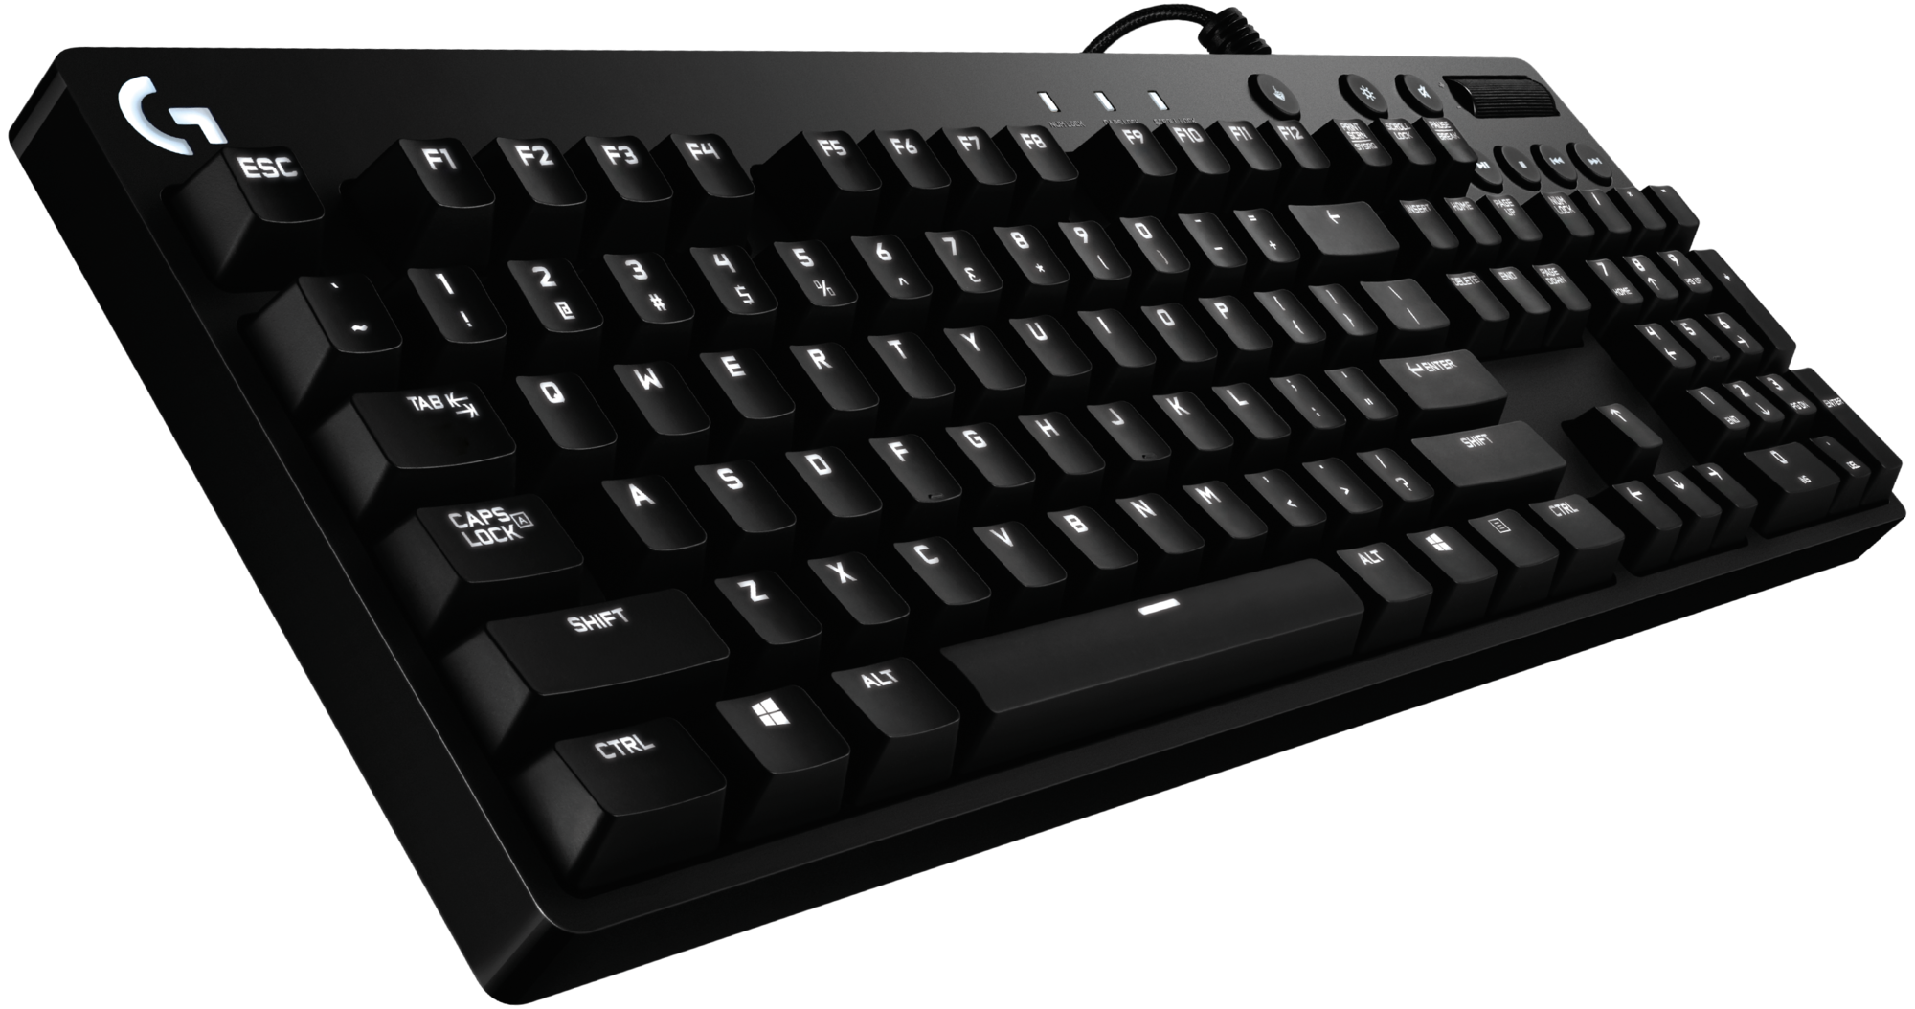
What is a HID-Device
A Human Input Device is an input peripheral such as a Keyboard, Mouse or Webcam.
HID Devices are “trusted” by operating systems and generally ignored by antivirus and antimalware.
Built in drivers allow for near universal connectivity.

Slide 3
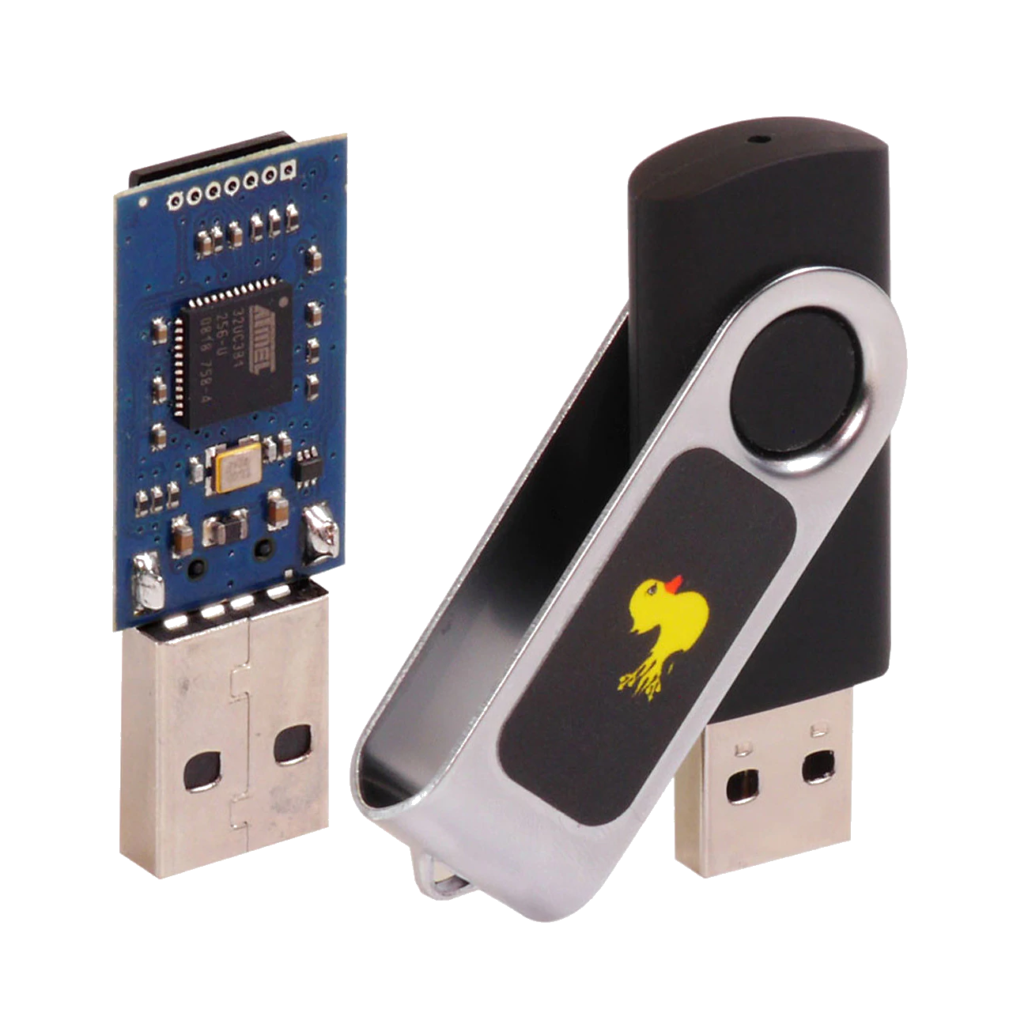
The USB Rubber Ducky
Created by the Hak5 group to utilize this concept for Cyber Security Penetration Testing.
Manipulates the firmware of a USB Device to “appear” like a Keyboard to the computer.
Execute scripts to execute preprogrammed keyboard inputs simulating a complicated Cyber Attack in milliseconds.
Loaded scripts through MicroSD cards allowed for easy disarming of the Ducky.
Costs when in stock around 60$

Slide 4
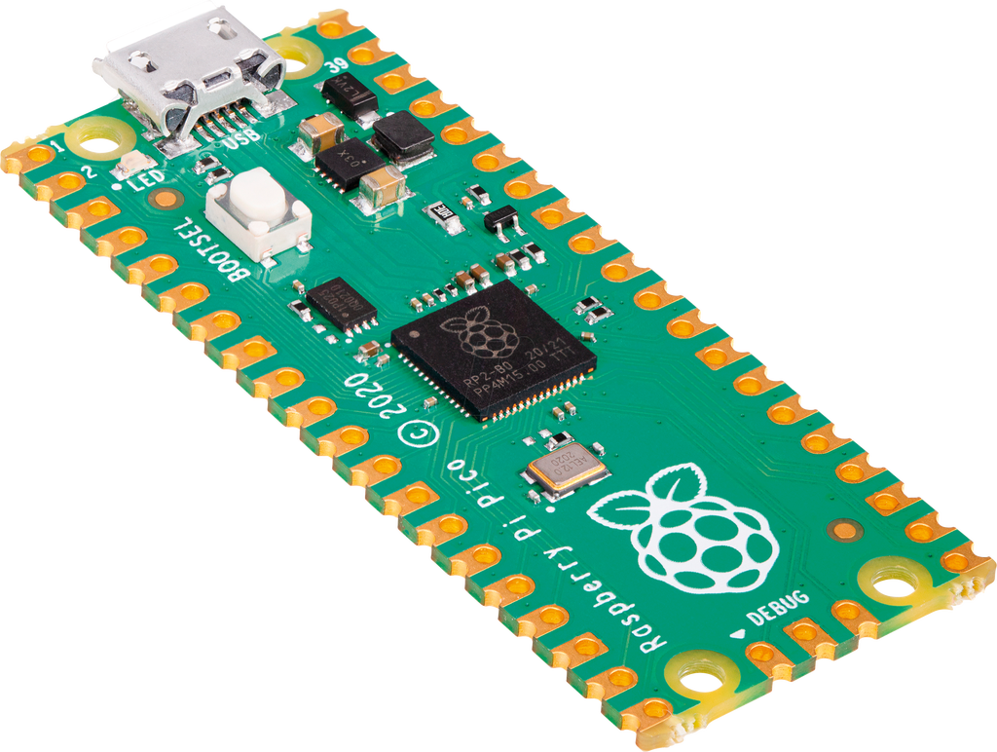
Step 1: The Board
The Raspberry Pi Pico costs about 4$.
100 MB of memory
USB Micro-B port for PC connection/power.
Boot-select Button for safety resetting and reformatting the device.

Slide 5
Pros:
Cheaper saving 56$
Effective at accomplishing the same tasks
Mimics devices other than a Keyboard
Cons:
Doesn’t look like a USB
Requires onboard payload instead of MicroSD

Slide 6

Step 2: Updating Firmware
Circuit Python is a Python based Programming Language designed for Microcontroller Boards
The .uf2 Firmware file for the Pico was created by Circuit Python in January 2021
With updated firmware the device will be able to execute Circuit Python scripts
“The easiest way to
program microcontrollers”

Slide 7

Step 3: Adafruit’s HID Library
Adafruit Industries developed libraries for Circuit Python.
Installation is as simple as dragging the HID lib folder into the lib folder on the Pico
The HID library developed allows for usage of both Keyboards and Mouses.
It’s recommended to use the .mpy library because its compressed and saves space.

Slide 8
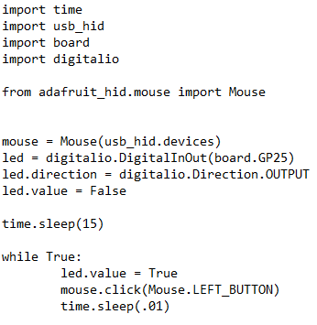
Step 4: The Code.py
An Auto-clicker with LED response
The Circuit Python executes the code inside the code.py file which hosts the Pythonic code and HID instructions.
While and If statements can be used to check the system OS when executing code and other properties.
Other functionality of the Pico including the LED IO can be used with the code.py.

Slide 9
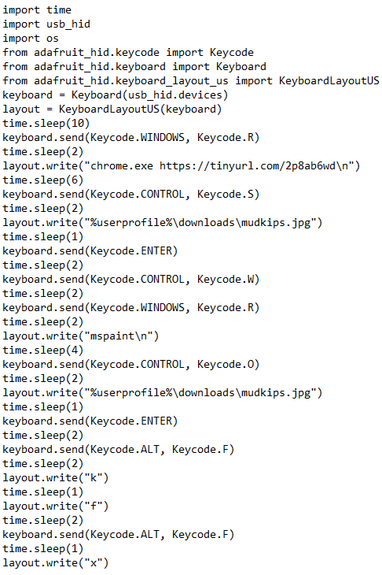
Basic Statements
time.sleep() – Used to pause the execution of code.
keyboard.send() – Used to input keycodes.
layout.write(“ ”) – Used to type a string.
Using /n to simulate the enter button for faster execution.
mouse.click() – Used to simulate the parameterized button press.

Slide 10

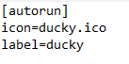

autorun.inf files
Older versions of Windows allowed for autorun.inf files to execute automatically from any USB.
Now the .inf files are best used to set the inserted devices icon and label.
Example of .inf config:

